Slide 1

Optimize and save your IT costs

Slide 2
Use self-managed AWS services to control costs
AWS Cost Explorer
The Pricing Calculator
Econmics Resources Center
Creating a billing alarm to monitor your estimated AWS charges

Slide 3

Reduce time to market with CI/CD & Release Automation

Slide 4
CONTINUOUS DELIVERY IMPLICATIONS
Reduce feedback loop with stakeholders
More time adding real value and Less time configuring infrastructure
Reduce costs detecting errors earlier
Increase revenue with faster and more frequent production deployments
Protect revenue with automated tests
Avoid responsibility silos with Continuous Delivery

Slide 5
KEY PERFORMANCE INDICATORS
 | Currently | With Continuous Delivery
Lead time to production | 2 days | 2 hours
Rollback rate | 6 out of 13 executions | 2 out of 10 executions
Time to failure | 4 days | 10 minutes
Production uptime | 3 hours | 14 minutes

Slide 6
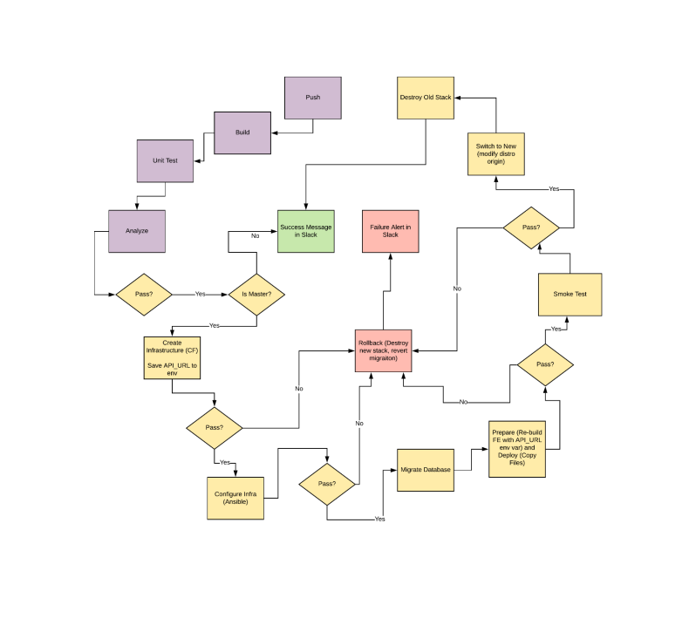
Current Manual Process Diagram

Slide 7
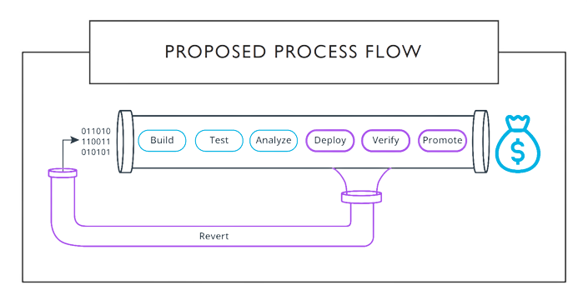
PROPOSED PROCESS FLOW

